Slide 1
Read Me: This deck contains two sections. One for participants and a second for coaches.
Participant section
This top section is a Tech Scenario description for participants. The section will cover the technology introduction and high-level concepts about the challenges.
Audience: Participants at OpenHack
Coach only section
This section is a Tech Scenario description for coaches. The section will cover the technology, challenge goals, common pit falls, general guidance on solutions. This section is presented to coaches in the ‘know before you go’ call a few days before the OpenHack starts. This section is intended to be more in-depth than the participant section. Do not share the coach section with participants!
Audience: Coaches at OpenHack
Section 1
Section 2

Slide 2

AI-Powered Knowledge Mining
#MSOpenHack

Slide 3
Knowledge Mining
Technologies
Azure Cognitive Services
Azure Functions
Azure Machine Learning
Form Recognizer
QnA Maker
Language Understanding Intelligent Service (LUIS)
is a broad term used to describe technological solutions that enable users to find the information quickly and easily from a large volume of data in a variety of formats and data stores.

Slide 4
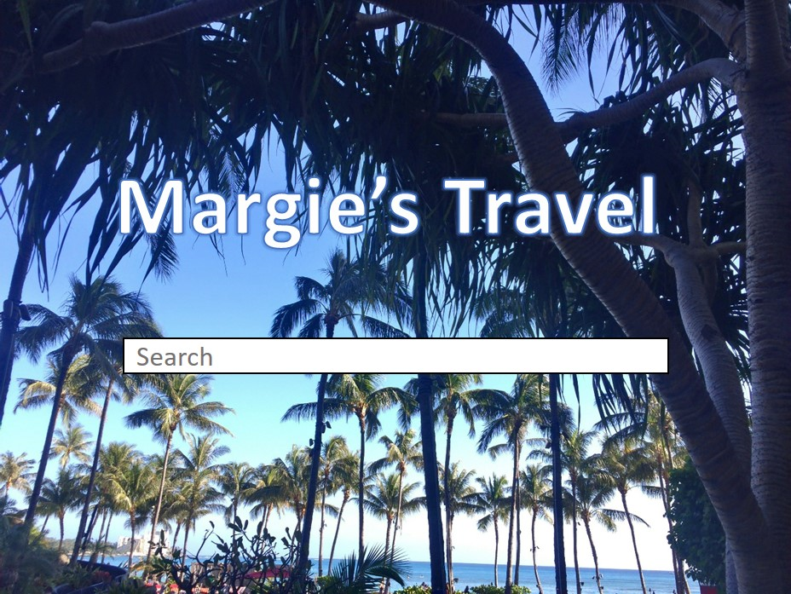
Scenario
You'll work in a team to help Margie's Travel, a fictional travel agent business, leverage Microsoft Azure to help customers and employees uncover information that is currently locked in documents and not easy to find.
You will build a complete Azure-based intelligent search infrastructure that can interpret vast quantities of diverse data from documents, images, and other digital artifacts.

Slide 5







Technologies and Concepts
QnA Maker
Azure Cognitive Search
Data source
Q | A
--- | ---
--- | ---
--- | ---
Built-in Skill
(Built on Azure Cognitive Services)
?
!
Skillset
Indexer
Knowledge Base
Client App (often a Bot)
Knowledge Store
QnA Maker Service
Custom Skill
(Web Endpoint – e.g. Azure Function)
Index
Notes:
This slide enumerates the key technologies that hackers will encounter in the challenges, and provides a visual representation of the high level conceptual architectures they will implement. Use it to provide a brief overview of the main concepts in a QnA solution and an Azure Cognitive Search enrichment pipeline – do not try to "teach" everything mentioned here – just provide a brief explanation pf each labelled element in the solutions so hackers can begin to form a mental model of the architectures they will meet in this OpenHack.

Slide 6
Feedback
Goal-Oriented – It states what is trying to be accomplished by the user
Specific – Gives details about the scenario, observations, and/or challenges faced by the user
Actionable – Provide necessary clarifying information to enable a decision

Slide 7

Let’s get started!
aka.ms/OHPortal
Login with the credentials supplied to your team.
Notes:
To get started, visit the OpenHack portal:

Slide 8
AI-Powered Knowledge Mining
Challenge walkthrough for coaches
Notes:
This guide is only meant to be a reference. Please do not rely on this guide in place of completing the challenges before coaching.

Slide 9
Challenge 1: A Question of Knowledge
In this challenge participants will use the Microsoft QnA Maker cognitive service to build and publish a knowledge base.
Learning objectives:
Create a QnA Maker knowledge base that includes suitable question and answer pairs
Write code that uses the SDK or REST API to query the knowledge base
Notes:
Challenge 1: A Question of Knowledge
In this challenge, you will use the Microsoft QnA Maker cognitive service to build and publish a knowledge base.
Learning objectives:
Create a QnA Maker knowledge base that includes suitable question and answer pairs
Write code that uses the REST API to query the knowledge base

Slide 10
Challenge 2: The Search Begins
In this challenge participants will create a data source, index, and indexer and demonstrate code that successfully retrieves information.
Learning objectives:
Create an Azure Search Index
Use the SDK or REST API to submit a range of search queries using both simple and full syntax
Notes:
Challenge 2: The Search Begins
In this challenge, you will create a data source, index, and indexer and demonstrate code that successfully retrieves the information.
Learning objectives:
Create an Azure Search Index
Use the SDK or REST API to submit a range of search queries using both simple and full syntax

Slide 11
Challenge 3: Expanding the Search
In this challenge participants will update the index and demonstrate code that successfully retrieves information.
Learning objectives:
Add built-in cognitive skills to an Azure Search index to return:
Key Phrases
Entities (including links)
Sentiment (especially reviews)
Notes:
Challenge 3: Expanding the Search
In this challenge, you will Update the index and demonstrate code that successfully retrieves information.
Learning objectives:
Add built-in cognitive skills to an Azure Search index to return:
Key Phrases
Entities (including links)
Sentiment (especially reviews)

Slide 12
Challenge 4: Getting the Full Picture
In this challenge participants will use the OCR skill to expand the index to extract AI-generated descriptions of images embedded in documents.
Learning objectives:
Add built-in cognitive skills to an Azure Search index to return:
Image Descriptions and Tags
OCR extracted Text
Notes:
Challenge 4: Getting the Full Picture
In this challenge, you will use the OCR skill to expand the index to extract AI-generated descriptions of images embedded in documents.
Learning objectives:
Add built-in cognitive skills to an Azure Search index to return:
Image Descriptions and Tags
OCR extracted Text

Slide 13
Challenge 5: What is the Frequency?
In this challenge participants will create a web API custom skill for the Azure Search index.
Learning objectives:
Create a custom skill to find the top ten most frequent words
Incorporate your custom skill into your web content index
Notes:
Challenge 5: What is the Frequency?
In this challenge, you will create a web API custom skill for your Azure Search index.
Learning objectives:
Create a custom skill to find the top ten most frequent words
Incorporate your custom skill into your web content index

Slide 14
Challenge 6: The Search for Relevance
In this challenge participants will create return search results based on synonyms and display suggestions and autocomplete options.
Learning objectives:
Add Synonyms to Azure Search index to ensure relevant results
Implement query suggestions / autocomplete
Add scoring profiles that boost documents in results
Notes:
Challenge 6: The Search for Relevance
In this challenge, you will create return search results based on synonyms and display suggestions and autocomplete options.
Learning objectives:
Add Synonyms to Azure Search index to ensure relevant results
Implement query suggestions / autocomplete
Add scoring profiles that boost documents in results

Slide 15
Challenge 7: Knowledge preservation
In this challenge participants will modify the index skillset to generate knowledge store assets. Browse the blobs and tables in the knowledge store using the Storage Explorer interface.
Learning objectives:
Implement knowledge stores
Notes:
Challenge 7: Knowledge preservation
In this challenge, you will modify the index skillset to generate knowledge store assets. Browse the blobs and tables in the knowledge store using the Storage Explorer interface.
Learning objectives:
Implement knowledge stores.

Slide 16
Challenge 8: Finding Your Form
In this challenge participants will train a Form Recognizer model and integrate into a new Azure Search index.
Learning objectives:
Create a custom skill that calls the Form Recognizer Service
Notes:
Challenge 8: Finding Your Form
In this challenge, you will train a Form Recognizer model and integrate into a new Azure Search index.
Learning objectives:
Create a custom skill that calls the Forms Understanding Service

Slide 17
Challenge 9: Use Your Intelligence
In this challenge participants will publish a machine learning model as a web service to predict claim probability.
Learning objectives:
Build a custom skill that consumes a custom machine learning model
Notes:
Challenge 9: Use Your Intelligence
In this challenge, you will publish a machine learning model as a web service to predict claim probability.
Learning objectives:
Build a custom skill that consumes a custom machine learning model

Slide 18
Coach solutions folder
https://aka.ms/OHCoachMaterials/AIKM

Slide 19
Thank you coaches!

